Slide 1


Design Thinking &
IDEA Lab
Transforming Ideas into Reality
Project Title: IoT-Based Monitoring System for Solar/Wind Microgrids
Batch Number: 6
Team Members Reg. No. & Name & Responsibility
1. Boobalan M(034),
2. Aswin Prasath K(028),
3. Gajeswaran B(056),
4. Gokul P(061)

Slide 2

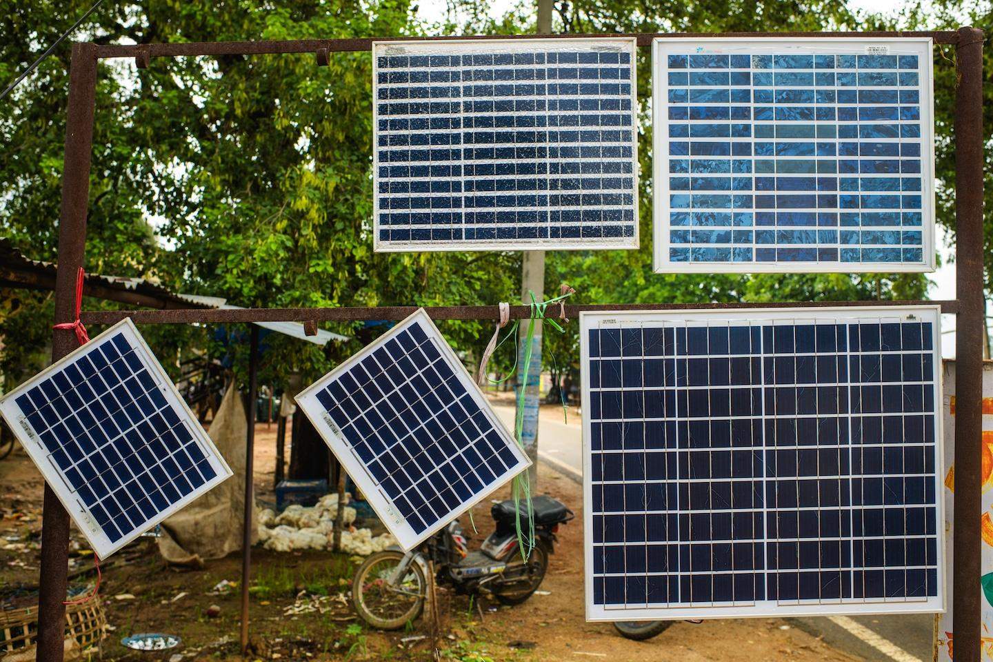
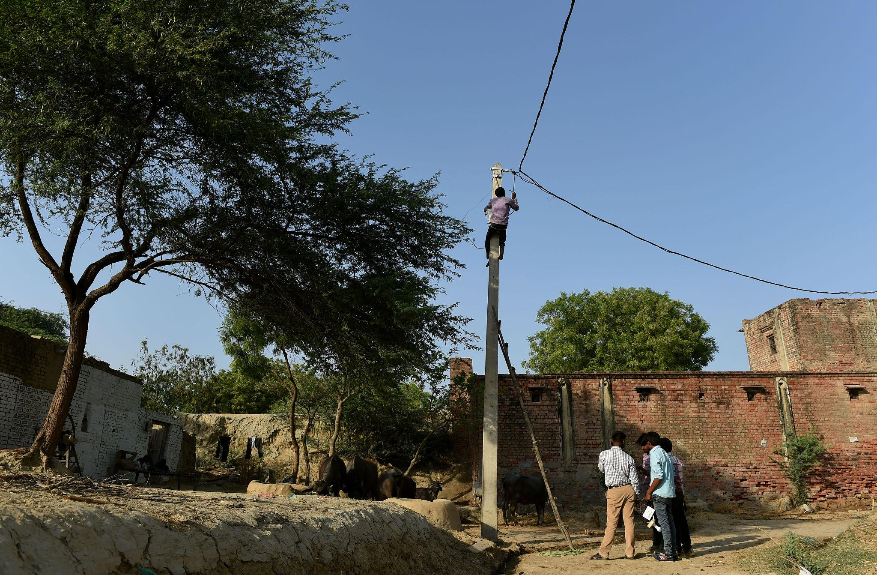
Problem Statement
No real time energy tracking
Battery failures goes unnoticed
  High Maintainence Cost
Inefficiencies reduce performance
Current solar/wind microgrids in rural areas face significant challenges that undermine their potential for reliable and sustainable power supply.

Slide 3
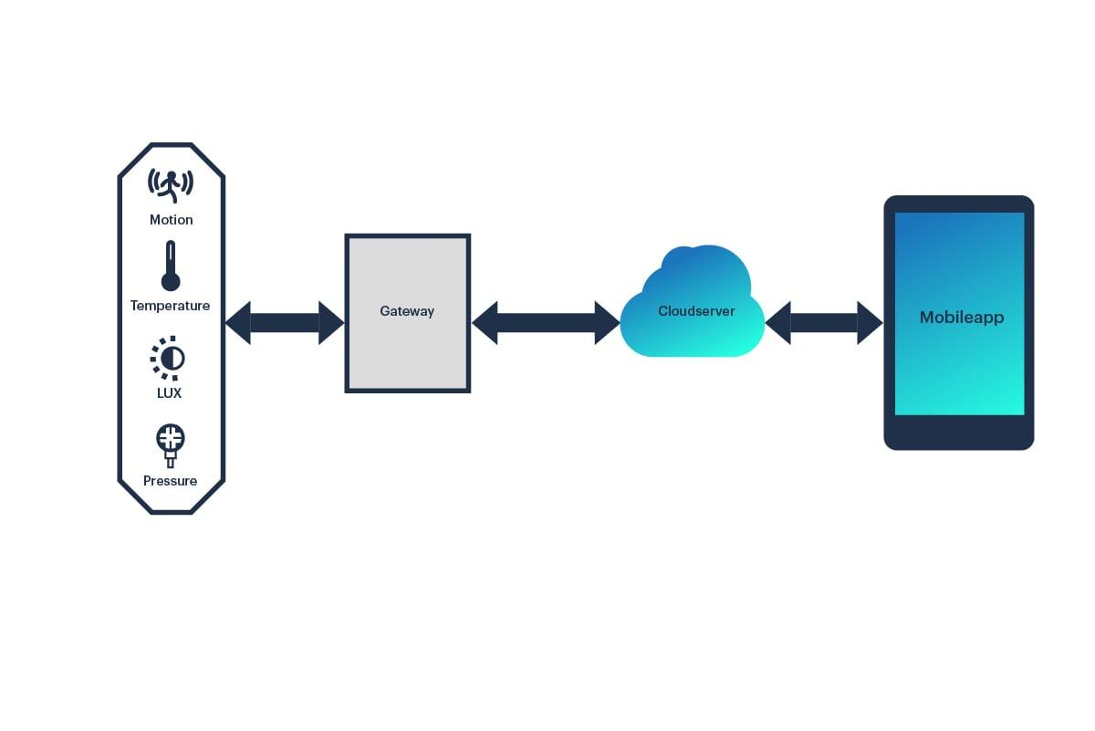
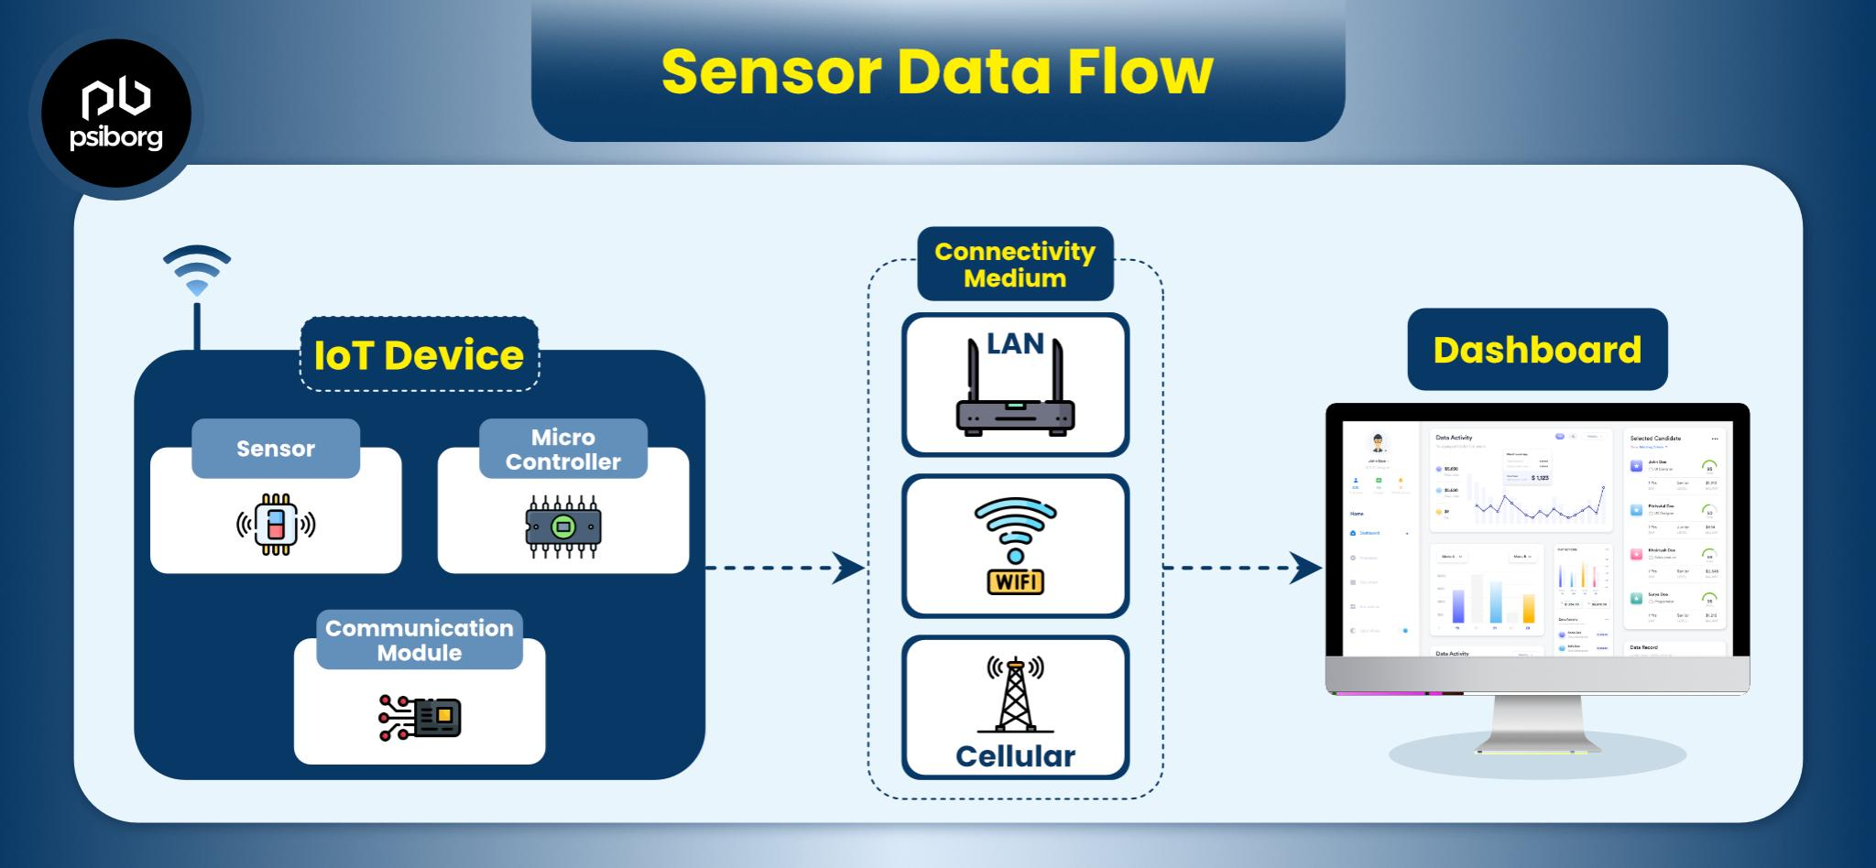
Define
IoT-based monitoring systems use sensors and the internet to monitor solar and wind microgrids.
They provide real-time data like voltage and power output.
They help detect faults early.
They allow monitoring and control remote.

Slide 4
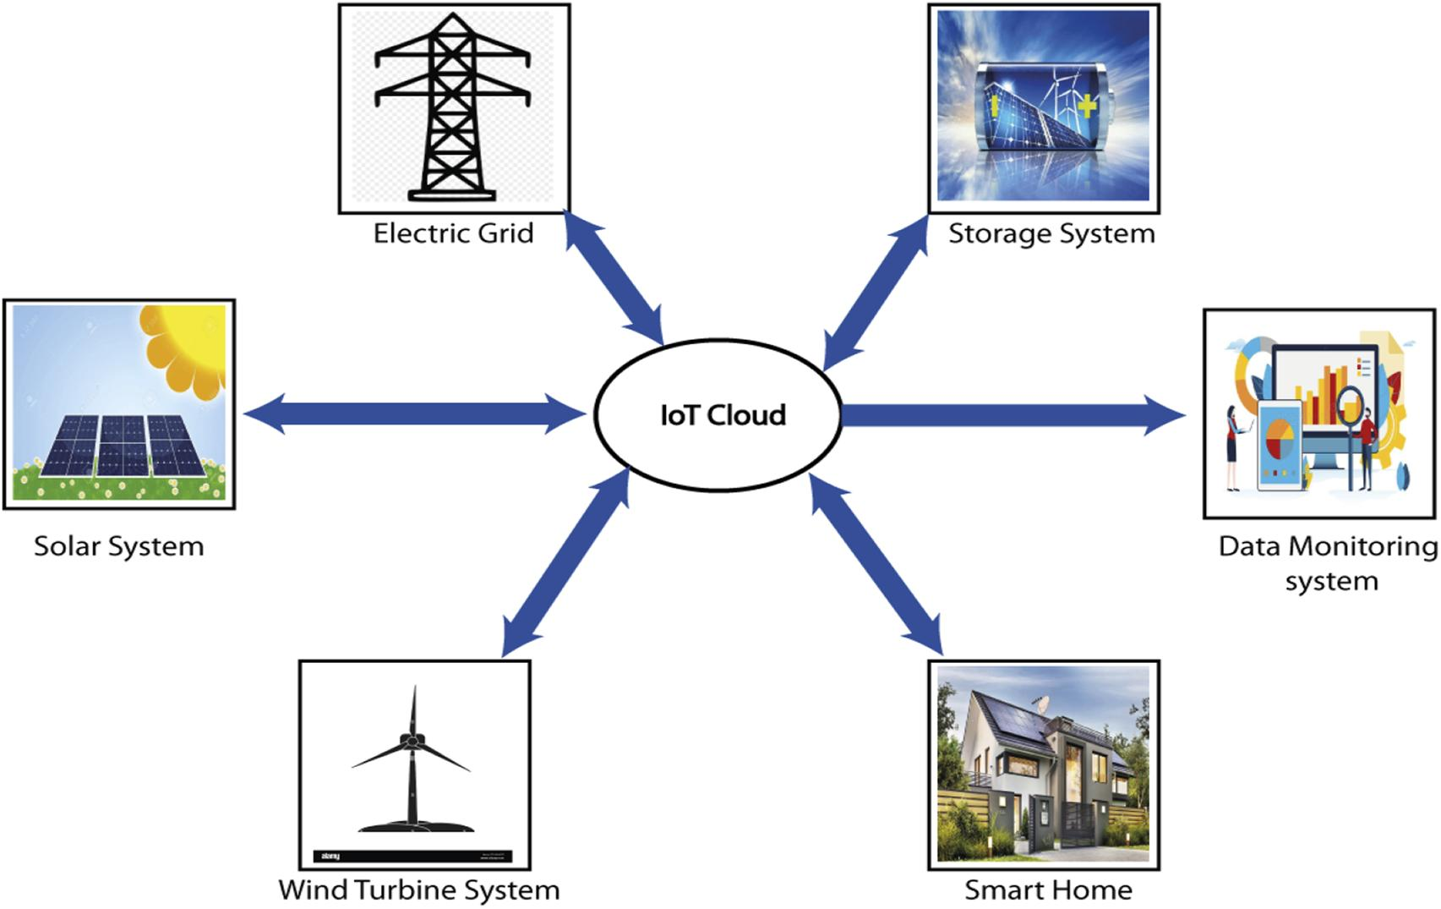
Proposed Solution
IoT-based monitoring system
Real-time data collection
Cloud storage & dashboard
Automatic fault alerts

Slide 5
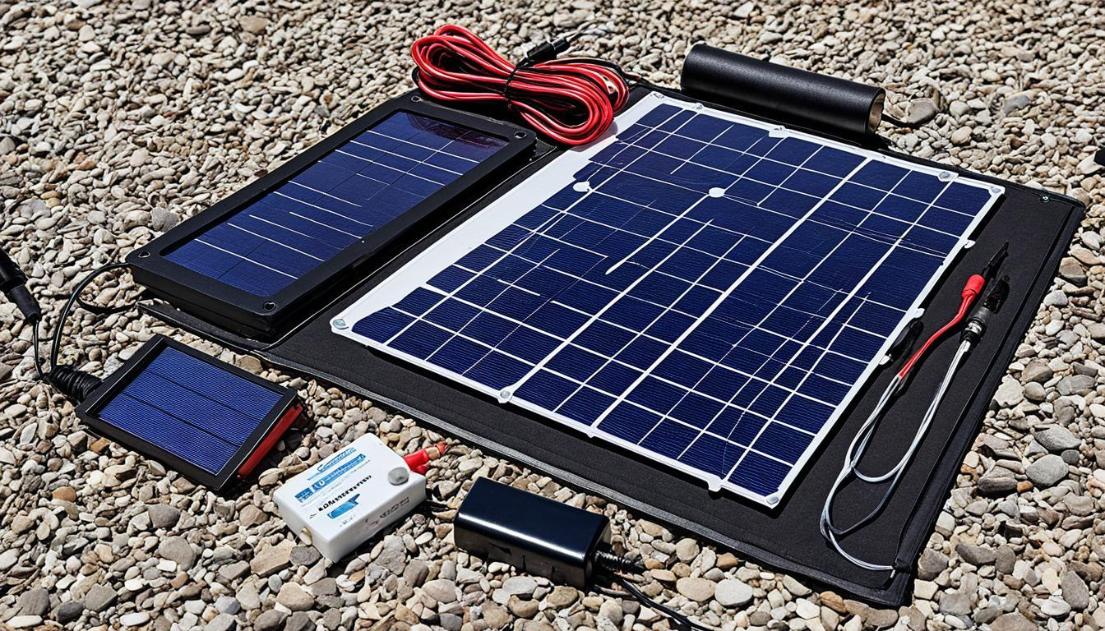
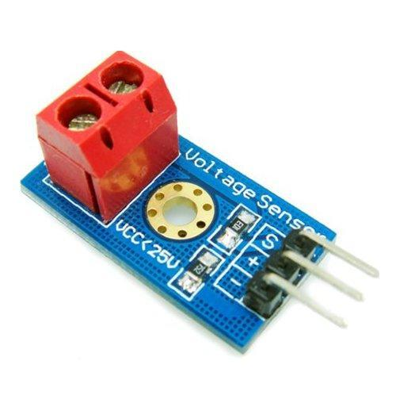
Prototype Development
Solar Panel / Wind Turbine
Voltage & Current Sensors
ESP32 Microcontroller
Battery & Charge Controller
Temperature Sensor
GSM/WiFi Module

Slide 6
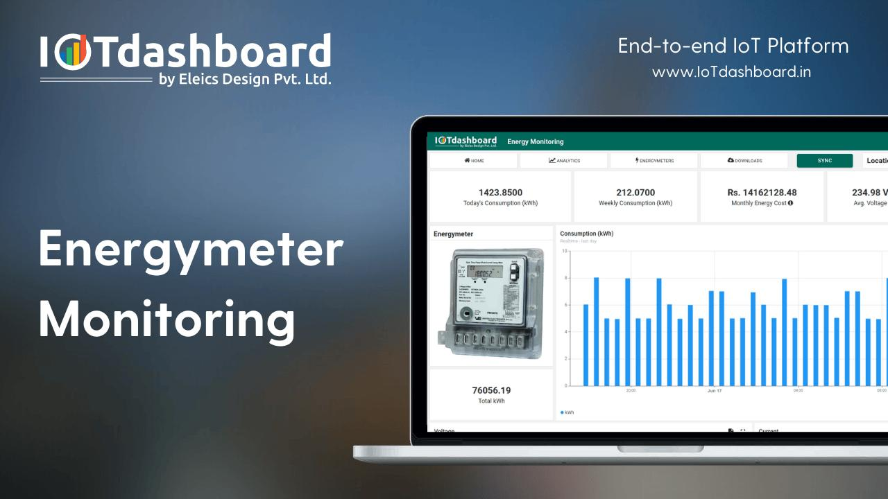
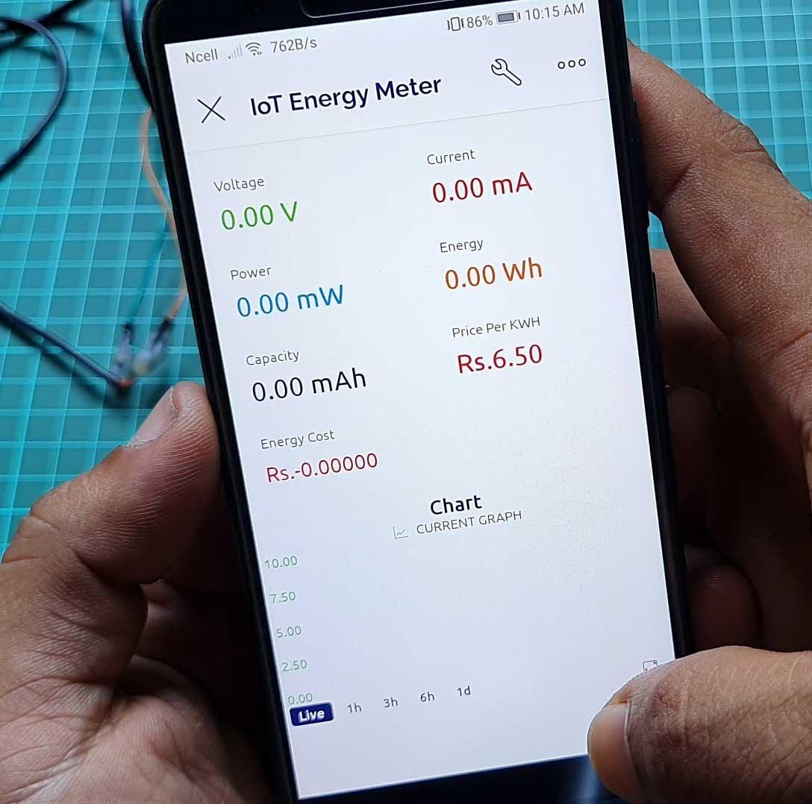
Prototype Development cont.,
Software & Working
Embedded programming (Arduino IDE)
Cloud platform integration
Power Calculation: Power = Voltage × Current
Battery % and efficiency monitoring

Slide 7

Conclusion
Enhances reliability of rural microgrids
Prevents unexpected failures
Supports sustainable energy systems
Scalable and cost-effective solution

Slide 8
Thank You
SKCET transform society through innovation and technology

